Slide 1
QMail: A Hybrid QKD/KEM Quantum Secure Email Client
CSE7101- Capstone Project
Review-2
Batch Number: CSE_42
Under the Supervision of,
Dr. Joseph Michael Jerard V
Professor
School of Computer Science and Engineering
Presidency University
Roll Number | Student Name
20221CSE0407 | S Pranav Roy
20221CSE0422 | Achal K A
20221CSE0185 | Satvik Varma
Name of the Program: Computer Science and Engineering
Name of the HoD: Dr Asif Mohammed
Name of the Program Project Coordinator: Dr. Jayavadivel Ravi
Name of the School Project Coordinators: Dr. Sampath A K , Dr. Geetha A

Slide 2
Problem Statement Number: PSCS_178
Organization: Indian Space Research Organization (ISRO)
Category (Hardware / Software / Both) : Software
Problem Description:-
Email communication is a vital component of modern business and personal interactions, yet conventional encryption methods remain susceptible to threats such as eavesdropping, man-in-the-middle attacks, and data breaches, especially in the emerging post-quantum era. Quantum Key Distribution (QKD) offers a higher level of security by enabling the secure exchange of encryption keys over a quantum channel, providing unconditional or enhanced protection against interception. This project proposes the development of QuMail, an email client similar to Microsoft Outlook that integrates QKD services with standard email protocols to secure communications while maintaining compatibility with widely used providers such as Gmail and Yahoo Mail. QuMail will interface with a Key Manager (KM) to retrieve quantum keys via APIs, connect with email servers through SMTP/IMAP protocols, and offer a graphical user interface for user interaction. In the intended use scenario, users with access to QKD-derived symmetric keys, pre-stored in local KMs, can exchange emails and attachments securely over untrusted networks. The system will begin with a key bank of 100 symmetric keys, each 1 KB in size. It will support three security levels: Level 1 – no quantum security, Level 2 – quantum-aided AES encryption using quantum keys as seeds, and Level 3 – quantum-secure encryption using the One-Time Pad. The key challenge is to design a robust and modular mechanism to integrate QKD into existing email infrastructures, ensuring interoperability, scalability, and the ability to upgrade KM services and authentication features as technology evolves.

Slide 3
Abstract
The emergence of commercial Quantum Computers is inevitable and only a matter of time. It poses a threat to current encryption algorithms, which are effective today but will be obsolete to Shor’s and Grover’s algorithms (Quantum algorithms), compromising confidentiality, integrity, and authenticity. Securing communication channels must be a top priority, and since email is the most widely used communication method, it must be addressed first. Our QMail, a Quantum Secure Email Client Application (QSECA), is designed to withstand both classical and quantum-level attacks. It uses a hybrid architecture of both Quantum Key Distribution (QKD) for session key and Post-Quantum Cryptography (PQC) for authentication and metadata protection, innovating on top of existing QSECA. The prototype features a user-friendly interface to choose between three levels of encryption, including OTP. Benchmarks on the prototype show the trade-off in latency, throughput, and encryption overhead compared to conventional email service. The results show that QMail ensures end-to-end security and provides resilience against adversaries with quantum capabilities. QMail establishes a foundation for a scalable, quantum-safe communication platform and is a step towards secure communication in the era of 6G and quantum internet.

Slide 4
Literature Review
https://docs.google.com/document/d/1zAwV58X2LKYtUTpi95S5t55ZLTdh9BErWewPbrnLV1o/edit?usp=sharing
1. Coverage
Reviewed 10 papers spanning:
Quantum Secure Email Clients
Quantum Key Distribution (QKD)
Post-Quantum Cryptography (PQC)
Secure Messaging & ProtonMail baseline
PQC Standardization (NIST)
Hybrid PQC + QKD frameworks
6G & Quantum Internet perspectives
2. Key Insights
QKD → ensures secure key exchange but faces cost & scalability issues.
PQC → NIST-standardized, software-feasible today, but large key sizes.
Existing Secure Email (ProtonMail) → private but not quantum-safe.
Hybrid Models → combining QKD + PQC is the most practical direction.
Future Vision → aligns with 6G networks and quantum internet development.
3. Gap Identified
No existing system provides a complete, practical, hybrid QKD + PQC email client with benchmarking.
4. Relevance to QMail
Literature validates the necessity and feasibility of QMail.
QMail addresses identified gaps by implementing and testing a prototype.

Slide 5
Objectives
To design and implement QMail, a Quantum Secure Email Client Application (QSECA).
Ensure confidentiality, integrity, and authenticity of email communication in the post-quantum era.
Develop a hybrid cryptographic model:
QKD for secure session key distribution.
PQC for authentication and metadata protection.
Build a desktop prototype with user-friendly encryption options (AES, OTP, hybrid).
Benchmark latency, throughput, and encryption overhead compared to conventional email systems.
Establish a foundation for scalable, quantum-safe communication platforms towards 6G and the quantum internet.

Slide 6
Existing Methods and Drawbacks
Classical Email Security (RSA, ECC, AES):
Strong today, but vulnerable to Shor’s and Grover’s algorithms in the quantum era.
ProtonMail (PGP-based E2EE):
Ensures privacy, but not quantum-safe; metadata (subject, sender) remains exposed.
QKD-based Prototypes:
Provide key secrecy but often rely on simulated hardware; scalability remains limited.
PQC Standards (Kyber, Dilithium, Falcon):
Secure against quantum attacks, but introduce key size and bandwidth trade-offs.
Drawbacks:
Lack of end-to-end hybrid solutions combining QKD + PQC.
Limited real-world validation, user-level applications, and benchmarking.
Existing systems either theoretical or partial — none fully practical for secure email.

Slide 7
Proposed Method and Feasibility Study
Innovative Solution: A hybrid architecture combining QKD for key distribution and PQC for authentication and metadata security.
Justification:
QKD ensures eavesdropper detection and secure symmetric keys.
PQC ensures scalability and immediate deployability using NIST-standardized algorithms.
Feasibility:
Technological: Prototype implemented with simulated QKD and PQC libraries.
Cost: Feasible with commodity hardware for prototype; real-world deployment scales with QKD infrastructure.
Resources: Desktop-based system, extendable to web/cloud in future.
Impact: Demonstrates a practical, tested model of quantum-secure email, bridging current limitations and future readiness.

Slide 8
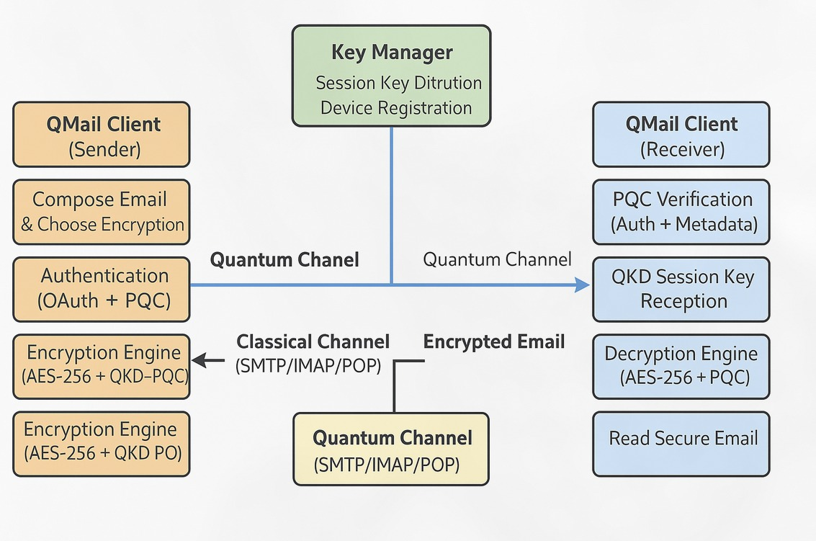
Architecture Diagram

Slide 9
Modules
User Interface:
Compose, send, and receive emails; select encryption level.
Authentication & Metadata Security:
PQC-based login, digital signatures, and secure header handling.
Key Management:
QKD-based session key exchange, with PQC fallback.
Encryption Engine:
AES encryption using QKD session keys, integrated with PQC.
Email Transmission:
Encrypted payload storage and routing via SMTP/IMAP server.
Attacker Simulation:
Models interception attempts to demonstrate resilience.

Slide 10
SDG Mapping
Relevant SDGs for QMail Project
SDG 9: Industry, Innovation, and Infrastructure
Contributes to next-generation communication infrastructure with quantum-secure email.
Supports innovation in cybersecurity aligned with 6G and the quantum internet.
SDG 16: Peace, Justice, and Strong Institutions
Ensures confidentiality, integrity, and authenticity of communications.
Protects individuals, enterprises, and institutions from cyber espionage, data breaches, and surveillance.
SDG 4: Quality Education
Provides a learning prototype for students and researchers in quantum communication and cybersecurity.
Bridges the gap between academic research and practical applications.

Slide 11
Hardware and Software Details
Hardware Details
Component | Minimum Specification | Recommended Specification
Client Laptop (Sender/Receiver) | Intel Core i5 (8th Gen) / AMD Ryzen 5, 8 GB RAM, 256 GB SSD | Intel Core i7 / Ryzen 7, 16 GB RAM, 512 GB SSD
Attacker Laptop (Demo) | Intel Core i3, 4 GB RAM, 128 GB HDD | Intel Core i5, 8 GB RAM, 256 GB SSD
Network | Stable broadband, 10 Mbps minimum | High-speed broadband, 50–100 Mbps for smoother IMAP/SMTP sync

Slide 12
Hardware and Software Details
Software Details
Layer | Tools / Frameworks Used
Operating System | Windows 10/11 (development & testing), Linux (server deployment)
Programming Languages | Python (core logic, crypto, UI)
Quantum Simulation | Qiskit (QKD simulation
Post-Quantum Cryptography | Open Quantum Safe (liboqs), PQClean (Kyber, Dilithium, Falcon)
Classical Cryptography | PyCryptodome (AES, hashing, OTP)
Database | MongoDB / MySQL (user data, metadata storage)
Server & Protocols | SMTP/IMAP/POP3 for email flow and OAuth
UI Development | Tkinter / PyQt for desktop client
Benchmarking Tools | Python scripts for latency, throughput, overhead analysis

Slide 13
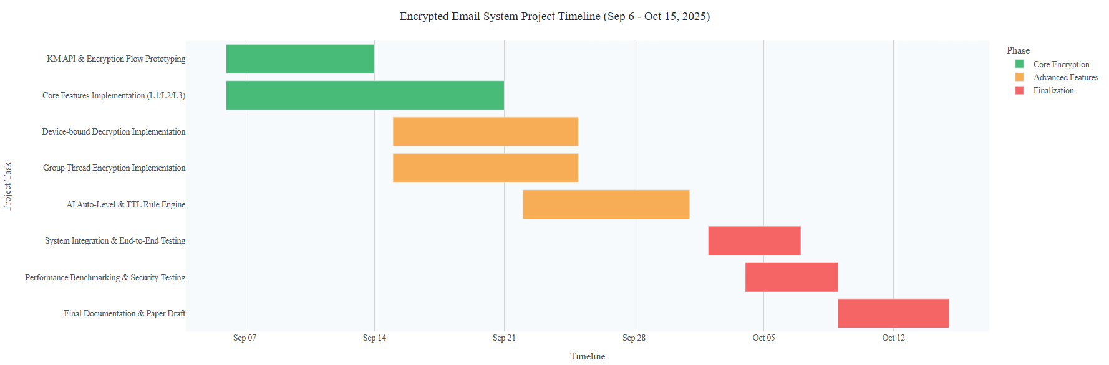
Timeline ( Gantt Chart )

Slide 14
References
Basha, M. S. H., & Saiteja, P. "Quantum Secure Email Client Application." Journal of Nonlinear Analysis and Optimization, vol. 16, no. 1, 2025.
R. G. Sharon, A. S. Kumar, and A. Mayan, "Quantum Encrypted Messaging Application: Harnessing Quantum Mechanics for Secure Communication," in 2024 2nd International Conference on Device Intelligence, Computing and Communication Technologies (DICCT), Dehradun, India, 2024, pp. 211–216.
G. S. Parvathi, K. N. Reddy, K. Harini, and K. Akshaya, "Revolutionizing Email Security with Quantum Key Distribution for Enhanced Data Protection in Communication Systems," Journal of Computational Analysis and Applications, vol. 33, no. 8, pp. 1426–1437, 2024.
Proton Technologies AG, "ProtonMail Security Features," Whitepaper, 2023. Note: As this is a corporate publication rather than a peer-reviewed paper, the citation follows an adapted IEEE format.
NIST, “Post-Quantum Cryptography Standardization,” National Institute of Standards and Technology, 2023.
A. Ghashghaei, A. A. Ahmadi, A. Sadeghi, and M. Esmaeili, “Enhancing the Security of Classical Communication with Post-Quantum Authenticated-Encryption for QKD,” Computers, vol. 13, no. 7, p. 163, MDPI, 2025.
D. Stebila, T. K. D. Nguyen, and M. Mosca, “Prototyping Post-Quantum and Hybrid Key Exchange and Authentication in TLS and SSH,” in Proc. 2nd NIST PQC Standardization Conference, Gaithersburg, MD, USA, 2019.
S. Mumtaz and M. Guizani, "An overview of quantum computing and quantum communication systems," IET Quantum Communication, vol. 2, no. 3, pp. 136–138, 2021, doi: 10.1049/qtc2.12021
A. Manzalini, "Quantum Communications in Future Networks and Services," Quantum Reports, vol. 2, no. 1, pp. 221–232, 2020, doi: 10.3390/quantum2010014
H. Dutta and A. K. Bhuyan, “Quantum Communication: From Fundamentals to Recent Trends, Challenges and Open Problems,” arXiv preprint arXiv:2406.04492, June 2024

Slide 15


